Slide 1
Fonds Gaston Paque (265365)
June 17 2009 at 1:06:12

Slide 2
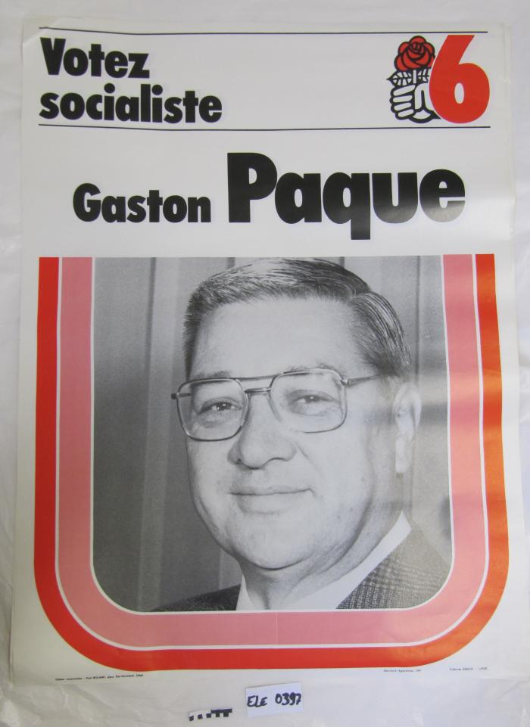
Votez socialiste (ARC-C AFF ELE 0397)

